Slide 1
Story # 3
Al Haque

Slide 2
Does stricter gun laws reduce firearms deaths
In this presentation I will answer the question
Does Stricter Gun Laws Reduce Firearms Deaths?

Slide 3
Domain Knowledge
The CDC publishes firearm morality for each state per 100,000 persons. Each states’ firearm control laws can be categorized as very strict to very lax
Gifford categorizes gun laws per state with Letter Grades with A being very strict gun laws and F denoting very lax gun laws
We will determine if firearms control laws per state aid in curbing firearms violence

Slide 4
Data Importing and Data Wrangling
I first had to retrieve the dataset from the cdc api after finally, retrieving the dataset I had to clean and retrieve rows that contain firearm related deaths and mortality rates in the 100k
I then joined the dataset with a csv containing Gifford gun law rating per state in order to get an understanding of the relationship between Gun laws rating per state and the firearms mortality rate
I converted Gifford Gun Laws to a 4.0 scale to make it easier to visualize on a color scale
Note: I cleaned and wrangled the data with Python and did visualizations with Excel Sheets.

Slide 5
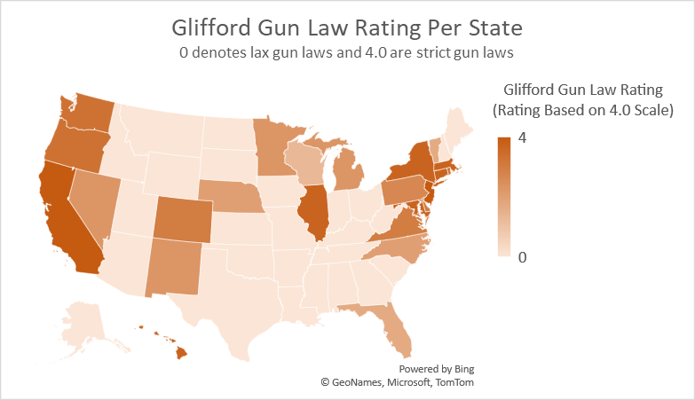

Slide 6
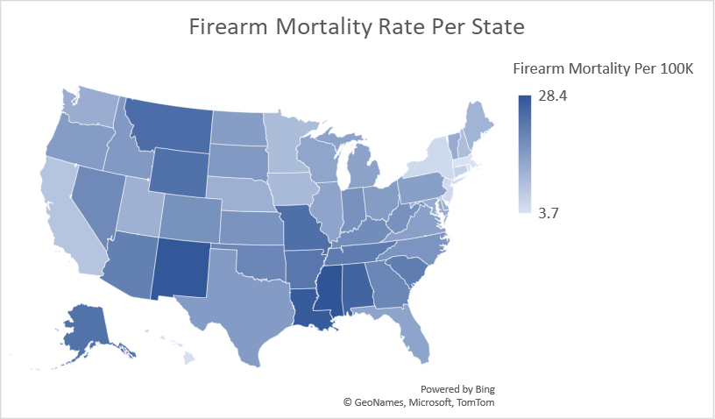

Slide 8
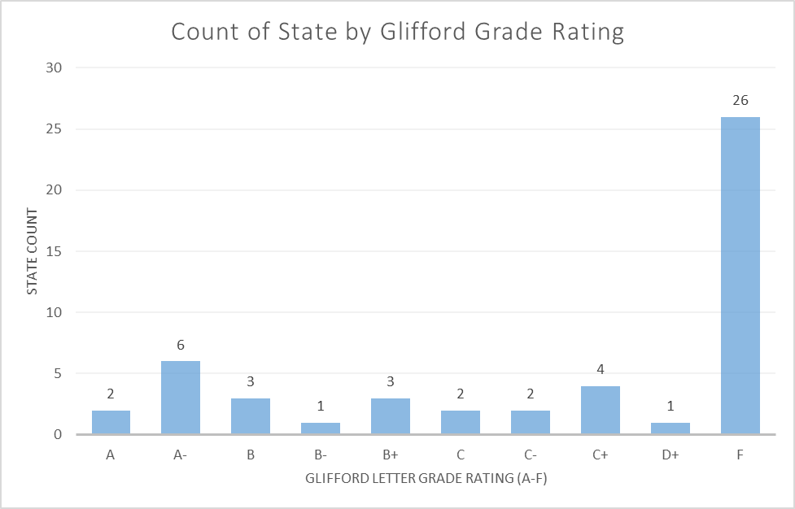
26 states have received an F grade while only 8 have an A grade

Slide 9
Conclusion:
Based on the visualizations, we can conclude that stricter gun laws lead to reduced firearms deaths. We can see for instance, states like California and New York are colored a dark red indicating they have strict gun laws and a rather low mortality rate as indicated by the light blue color on the legend. Vice-versa we see states like Alabama and Alaska with rather high firearm mortality rate and a gun law score of 0 as shown of the color and the legend. Hence, stricter gun laws reduce firearms mortality rate, vice-versa lax gun laws lead to increased firearms mortality rate

Slide 10
References:
https://dev.socrata.com/foundry/data.cdc.gov/489q-934x (Socrata API)
https://giffords.org/lawcenter/resources/scorecard/ (Gifford Gun Law Scorecard)
https://www.pewresearch.org/short-reads/2023/04/26/what-the-data-says-about-gun-deaths-in-the-u-s/ (Some Domain Knowledge To Understanding…)

